Slide 1

Project Team: Lauren Parrish, zehra tokatli, Chase Webb

Slide 2
Background:
Remember going to the movies?
It seems like a bygone activity of yesteryear, but yes people did go to movie theaters. With the advent of streaming services and well Covid, most of us are enjoying film from the comfort of our couch. We have many movie options! How do we know if what we select is “quality” and if something is “quality” is it something the average streamer really wants to watch?
We extracted data from an Academy Awards Database and a Streaming Services database to try and determine:
Do award winning films actually have high user ratings?
Do awards impact film popularity on streaming services?
Do award winning directors receive higher ratings?
Do films with winning soundtracks have higher popularity?

Slide 3
Extraction:
Data Sources:
The team leveraged a csv database from Kaggle containing streaming services which included film names, user ratings, service providers, and directors.
https://www.kaggle.com/ruchi798/movies-on-netflix-prime-video-hulu-and-disney
The second source was JSON database from DataHub containing Oscar nominees and winners.
https://datahub.io/rufuspollock/oscars-nominees-and-winners
Both data sets were downloaded from their corresponding websites and loaded into Jupyter Notebook for Transformation.

Slide 4
Transformation:
Data Cleanse:
Summary of Streaming Data Cleanse:
Drop empty columns
Remove rows that did not contain rating information
Split First and Second Director, drop any additional director information
Split Location cell into Primary and Secondary Location, drop other locations
Split Language into Primary and Secondary Language, drop other languages
Split Genres into eight separate columns
Convert streaming services cells to Booleans
Challenges:
The data contained cells with multiple data points separated by commas. Some cells were not applicable for the team’s analysis and thus the decision was made to drop any additional data elements post the primary and secondary listing. The exception was genre information which was split to populate eight new genre columns.

Slide 5
Transformation:
Data Cleanse:
Summary of Awards Data Cleanse:
Identify unique fields;
Combine data with similar music categories;
Combine data with similar short film categories;
Combine data with similarities for cinematography, art direction;
Identify winning actors;
Identify winning best pictures;
Remove “year_ceremony” and “ceremony” columns.
Challenges:
The greatest challenge with the Awards dataset was that there were several columns containing similar categories. This level of detail was not required for the team’s assessment and therefore the data was merged. As we progressed through the initial dataset, we found that it would be difficult to join to the other dataset, so a new source file was used which listed film titles.

Slide 6
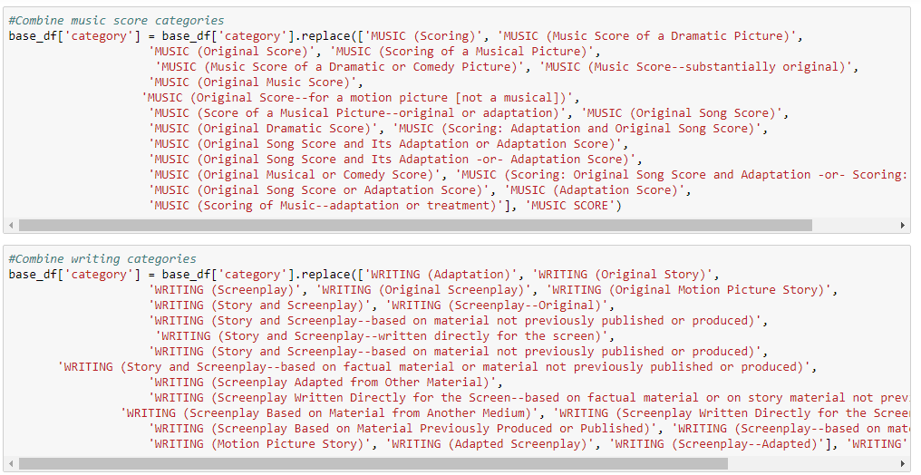
Transformation:
Data Cleanse:

Slide 7
Transformation:
Data Joins:
Heading:
Text
Heading:
Text

Slide 8
Loading:
Insert headline
Insert Text

Slide 9
Conclusion:
Insert headline
Insert Text

